Slide 1







SIGNSPEAK
TEAM SVK MEMBERS :
Kareena Tuli - E22CSEU0269
Saquib Hussain - E22CSEU0341

Slide 2


Content
1
Problem Statement
2
Dataset
3
Tools and Framework
4
Results and Observations
5
Novelty Factor

Slide 3

Problem Statement
Sign language is the primary means of communication for millions of speech- and hearing-impaired individuals.
In India, Indian Sign Language (ISL) lacks accessible and widely adopted technological solutions.
Existing translators are often limited by:
Low accuracy in dynamic environments
Poor real-time performance
Inability to form complete sentences
There is a need for a reliable, real-time, and accurate ISL translator that bridges this communication gap.
SignSpeak recognizes ISL alphabets and enables sentence formation with speech feedback.

Slide 4


Dataset Used
Dataset created manually using webcam and OpenCV
27 gesture classes: A–Z + BACKSPACE
~100 images per class (2,700+ total)
Images captured with 3-second countdown to ensure stable hand pose
Preprocessed using MediaPipe to extract hand landmarks:
→ Each sample: (2 hands × 21 landmarks × 2D) = (2, 21, 2)

Slide 5

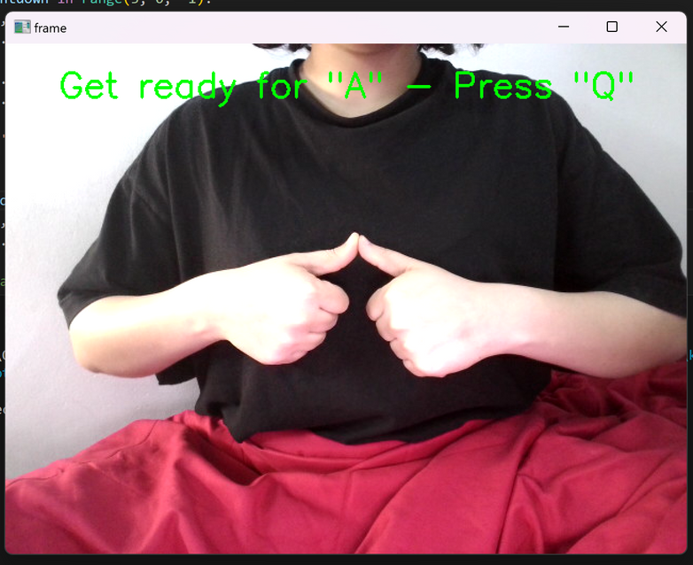
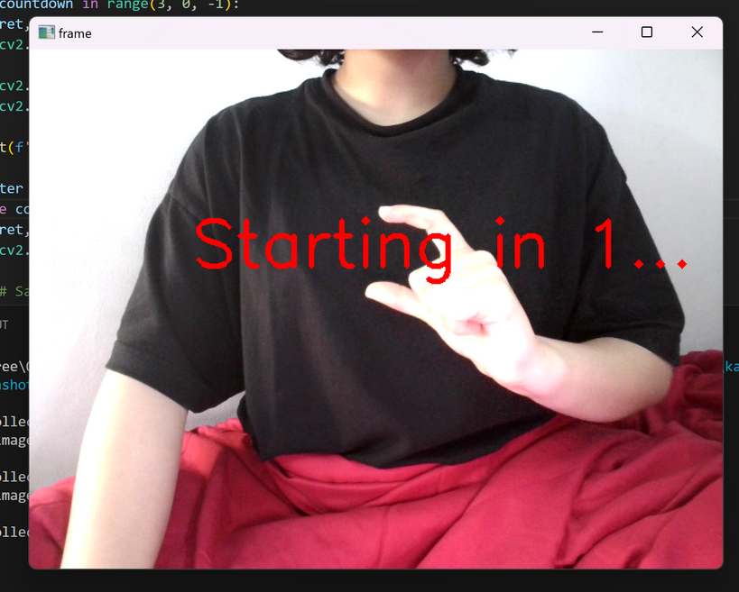
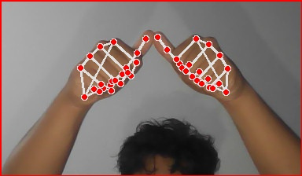




Dataset Creation Process
Dataset creation
Dataset creation
Landmark Detection
Press ‘Q’ before capturing images.
Countdown before capturng
Using mediapipeline

Slide 6




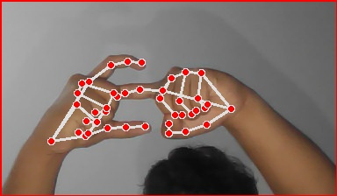
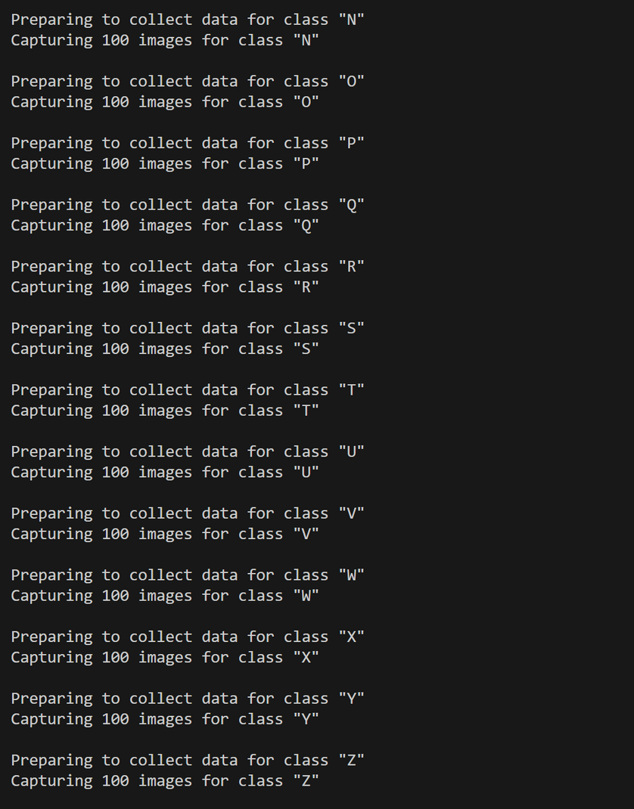
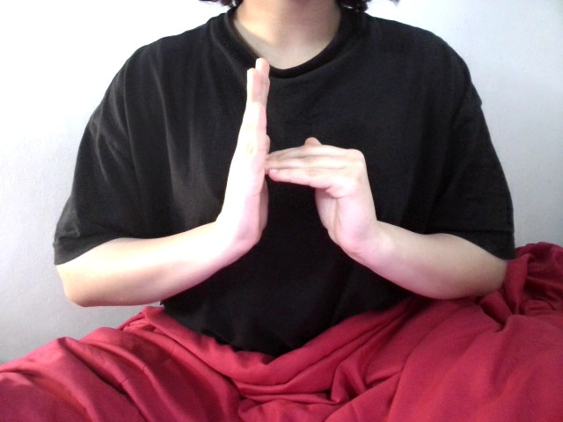
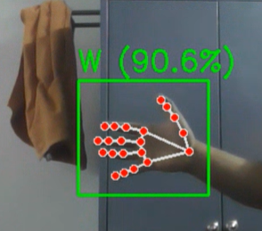
Dataset Creation

Slide 7


Tools Used
Programming Language
Python 3.9.x
Computer Vision
OpenCV – for webcam input and image capture
MediaPipe – for hand landmark detection
Machine Learning
TensorFlow / Keras – for CNN model design and training
NumPy – for array and data preprocessing
scikit-learn – for label encoding and data splitting
pickle – for saving and loading data
Real-Time Logic
collections.deque – for buffered prediction
time – for gesture timing and delays
Text-to-Speech
pyttsx3 – for offline speech synthesis

Slide 8

Framework
1. Dataset Collection
Capture A–Z + BACKSPACE gestures using webcam and OpenCV
Save images into labeled folders
2. Hand Landmark Extraction
Use MediaPipe to extract 21 (x, y) hand landmarks
Normalize and pad to shape (2, 21, 2)
3.Data Preprocessing
Organize landmark arrays and labels
Save as .pickle for training
6. Prediction (CNN Model)
Process landmark array → CNN model
Predict most likely gesture class
5. Real-Time Webcam Input
Capture frame from webcam
Run MediaPipe to detect hand landmarks
4. CNN Model Training
Train a CNN on landmark data
Output = 27 classes (A–Z + BACKSPACE)
7. Buffering & Stabilization
Add predictions to sliding buffer
Accept only confident and consistent predictions
9. Speech Output
On keypress S, use pyttsx3 to convert sentence to audio
Play audio and reset sentence
8. Action Based on Prediction
A–Z → Add to sentence
BACKSPACE → Remove last character
SPACE → If no hands detected for 2 seconds

Slide 9
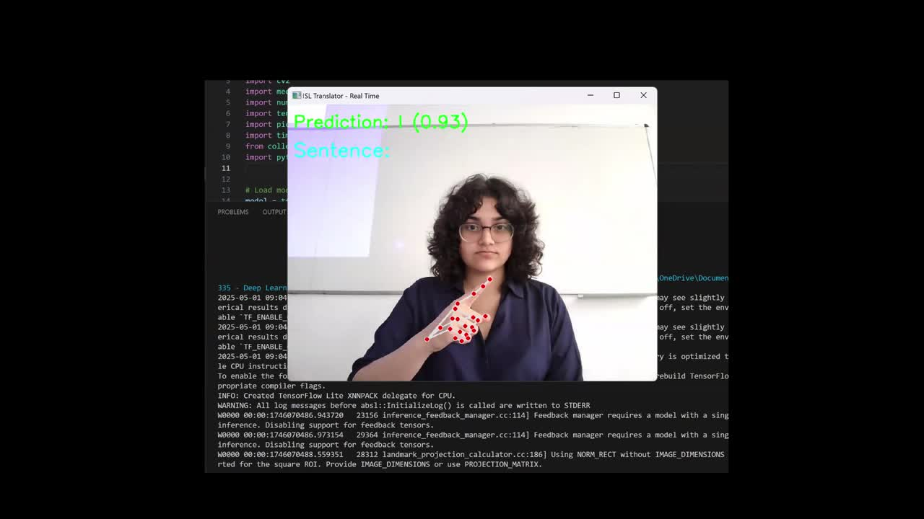
Results

Slide 10

Results
RESULT 1
RESULT 3
Model Accuracy
Achieved 93% validation accuracy using CNN on landmark-based dataset.
Real-Time Performance
Average prediction time: 78.61 ms per frame (runs smoothly on CPU).
RESULT 2
RESULT 4
Gesture Handling
SPACE triggered by no-hand detection; BACKSPACE handled via custom gesture class.
Speech Output
Sentence converted to speech on keypress ‘S’ using pyttsx3 (offline TTS).

Slide 11

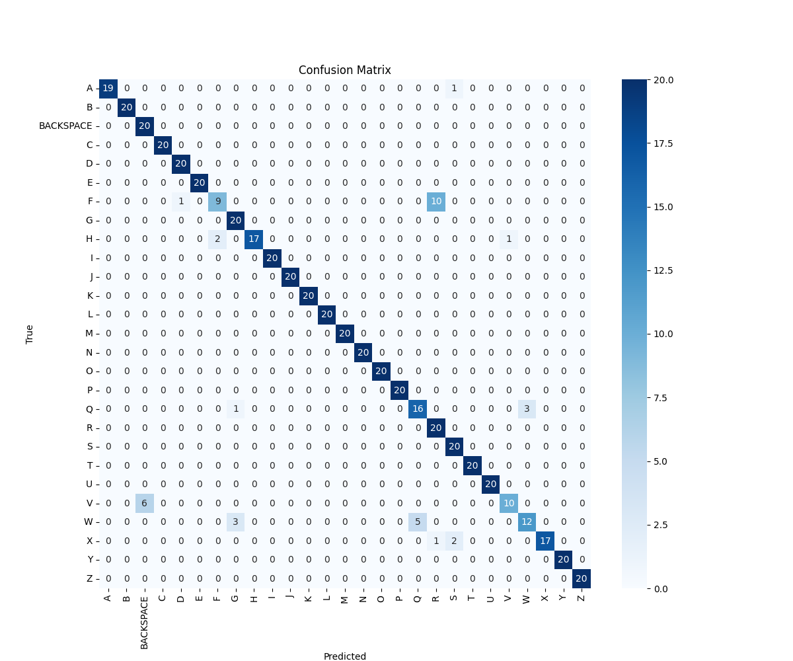
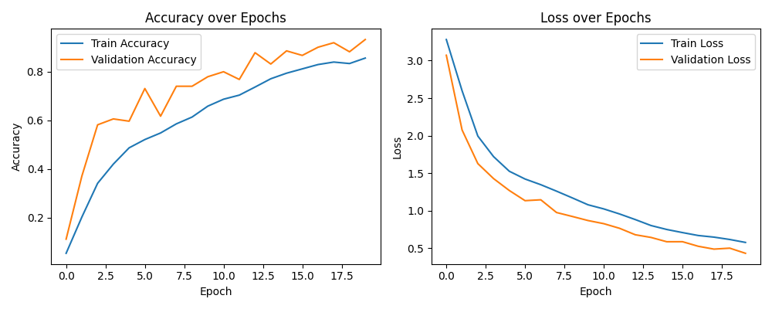
Performance Evaluation

Slide 12
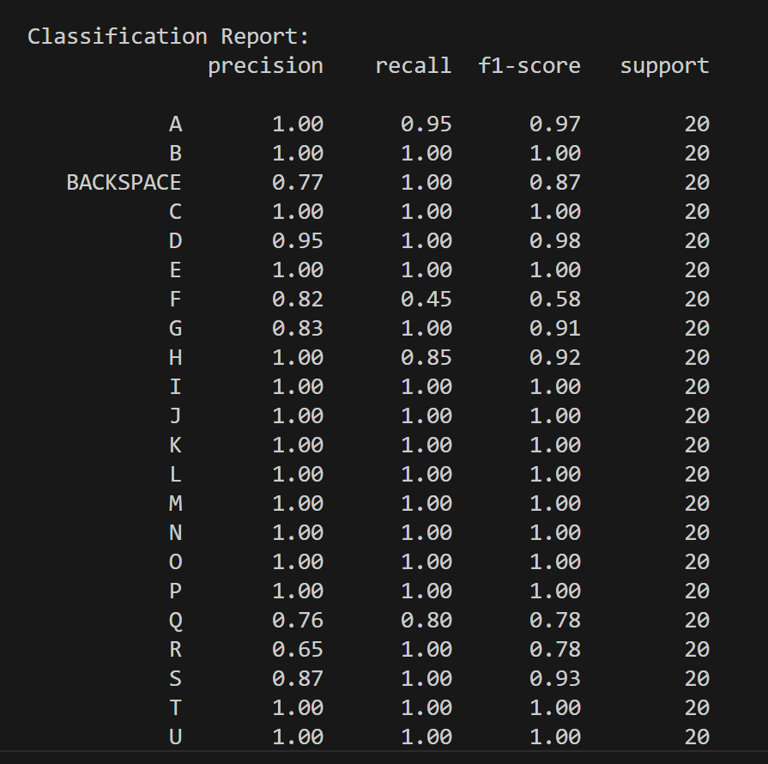
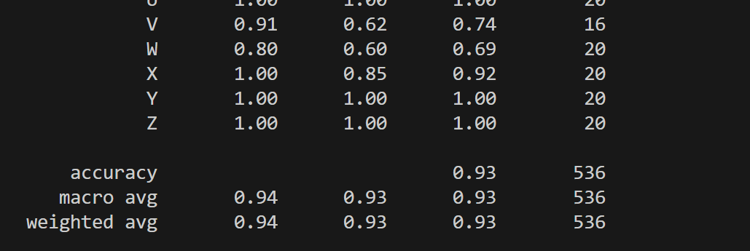
Performance Evaluation

Slide 13

Novelty Factors
Real-time Indian Sign Language (ISL) translator built using hand landmarks instead of raw images
Support for two-hand gestures using MediaPipe’s landmark detection
Custom class for BACKSPACE gesture trained alongside alphabet classes
SPACE functionality implemented using a rule-based no-hand detection method
Stabilized predictions using a buffer to reduce misclassifications across frames
Integrated sentence formation with live speech output triggered by keypress
Designed to run in real time on CPU systems with minimal resource requirements

Slide 14
THANK YOU

